Slide 1
Advocacy for the use of NTAs to support countries in monitoring progress towards SDGs, and Agenda 2063 in West Africa
Bakary DOSSO
Chief Demographic Dynamics for Development Center
ECA/SRO-WA
Niamey,Niger
July 7 , 2020
Niamey, Niger

Slide 2
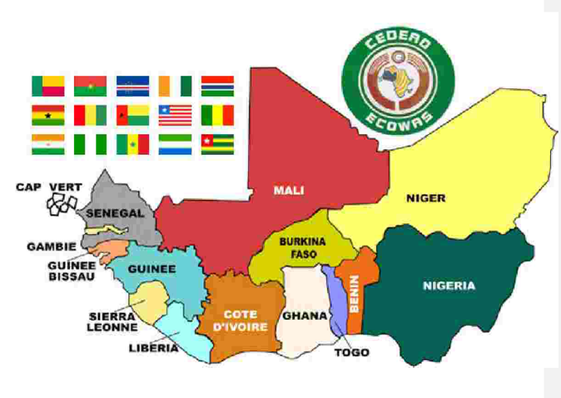
ECOWAS
Notes:
ECOWAS main mandate is to promote cooperation and integration among its 15 Member States, economic and political stability and to increase economic opportunities for its peoples as well as their level of well-being
ECOWAS is one of the building blocks of the African Union. As such, it has decided to implement the road map of the African Union to harness the demographic dividend through investments in youth.

Slide 3
Demographic transition not completed
Huge Social Demand
TFR in 2015-2020
Low structural transformation
In 2018, ECOWAS accounts for 26.3% of Africa's GDP.
Fragile States (Terrorism in BF, Mali, Niger, igeria)
High incidence of poverty rate
Inadequacy of programs curricula to labor market needs
Population
397.2 millions in 2020 as 29.6% of Africa
from 2.29 (Cabo Verde to 6.95 (Niger)
Average : 5.18 while 4.44 (Africa)
Under 15: 43.2% & Youth 15-24: 19.7%
Growth rate: 2.7% in 2015-2020
Weaknesses of Governance Indicators (WGI)
Vulnerable Employment : 78.6% (ECOWAS) vs
44.6% (World) in 2019
weak structural transformation based on raw materials
Real GDP growth rate: 3.8% vs 2.7% for Africa in 2010-2018
Budget balance excluding grants ranges from -2 % (BF) to -11.5% (GB) of GDP in 2019
Low Level of skills and insufficient human resources of sufficient quality
Notes:
Real GDP growth rates in 2019: Varies from 0.4% (Liberia) to 7.7% (Mali). Top5 Main growth drivers: Mali (7.7%) Benin (7.6%), Côte d’Ivoire (7.5%), Ghana (7.1%), Niger (6.3%)
Nigeria (2.3%)

Slide 4
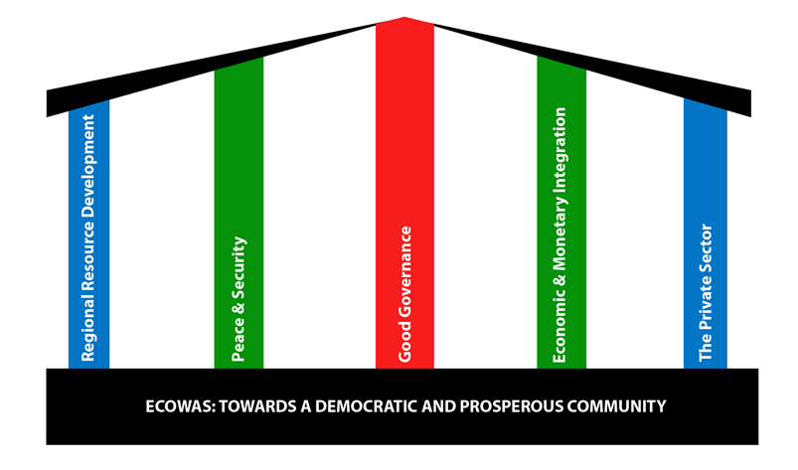
ECOWAS Vision 2020 and Human Capital
We envision by 2020 - An inclusive society achieved through human capital development and empowerment, and offering a peaceful and healthy environment where women, children and youth thrive and have equitable access to resources and opportunities – social cohesion that assures these hitherto vulnerable groups their rightful place in society

Slide 5
Demographic dividend defined as Economic growth potential that can be realized when the increase in the working age population is transformed into human capital which participates in the production.
The contribution of human capital to growth is the combined effect of investment in education and health, a youth employment policy and good governance
Progress towards the SDGs and Agenda 2063 is correlated with demographic dynamics

Slide 6
Ongoing Regional initiatives and the upcoming ECOWAS Vision 2050
National demographic dividend observatories implemented with the financial and technical support of SWEDD, UNFPA and CREG.
A national Budgeting framework sensitive to Demographic Dividend rolled out in Mali with the support of the ECA and CREG
Advocacy for demo-economic data collection, analysis and dissemination with the support of ECA

Slide 7
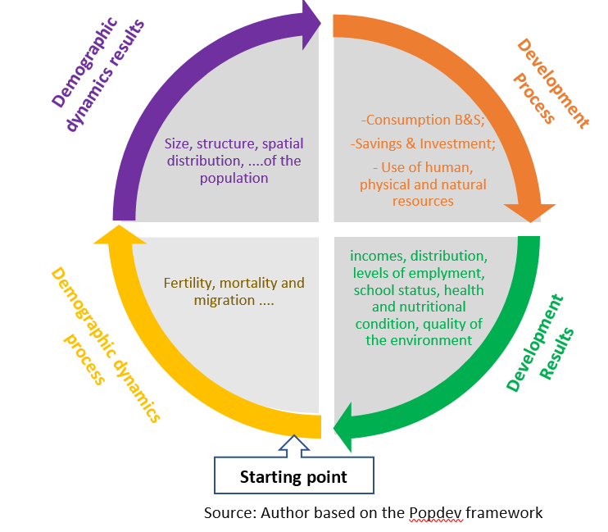
Data Framework for population dynamics for development

Slide 8
Regional ECOWAS Profile
Age: 31
Age: 62
US $ 173.731 Bn
US$ 566.46 Bn
Summary (Amount in Billion USD)
Life Cycle Deficit (LCD) | Youth (0- 30 years) | 566.464 |  | 96.5%
 | Old (63 years and +) | 20.745 |  | 3.5%
Surplus (31 - 62 years) |  | 173.731
Life Cycle Deficit Global (LCD) |  | 413.478 | 28.6% of GDP | 28.6% of GDP
Source: CREG & ECA, 2020

Slide 9
Source: CREG & ECA, 2020
Notes:
Microeconomic analysis and children labour

Slide 10
Projections of DD for ECOWAS by TFR scenarios
Source: CREG & ECA, 2020

Slide 11
Key messages
Economic variables are age dependents. Economic lifecycle deficit (LCD) is an excellent indicator of the social demand. ECOWAS generations run lifecycle surpluses between ages 31 and 62 and the LCD represents 28.6% of the GDP of the region.
The window of opportunity of the DD in West Africa will reach the maximum in 2045. The region should implement structural policies to create decent jobs for youth (economic and structural transformation). Prepare population aging from 2045.
Collection of demo-economic data in West Africa required major data collection operations (GPHC, EDS, Survey on Household Living Conditions, Population Registers Operation Systems, System of National Accounts, Education, Health, Environment, Migration etc.).
Most of those operations are conducted irregularly. As a result, several important aspects of the DDDs are poorly or not covered by official statistics.
Notes:
From 2045: Aging should be the issue

Slide 12
Policy recommandations
Policy dialogue with the ECOWAS Commission to ensure that the Vision 2050 is informed by the findings of available knowledge on population dynamics
Advocate for the establishment of a DD monitoring programme by the ECOWAS Commission
Advocate for the use of NTA indicators in the ECOWAS regional Convergence Report as indicator of social integration in West Africa (Life cycle deficit, Economic Support Ratio, etc)
Build capacity of national statistical offices and advocate for regular production of the data ecosystem needed for the production of national and regional NTA profiles

Slide 13
THANK YOU!

